Slide 2

Transitioning to Drake Middle School

Slide 3




6th Grade Teams
Cosmic Cats
Leopards
Panthers
Pumas
Tigers
Notes:
This year at Yarbrough we have 3 5th grade teams. Next year at Drake you will have 5 teams.
IF you are registered for school you will receive a letter this summer letting you know the team you are on.

Slide 4

Class Schedule
7 classes a day
1.Language Arts
2.Math
3.Science
4.Social Studies
5.Physical Education
6.Exploratory (Changes every 6 weeks)
7.Lunch/ IE ( Intervention Enrichment)
Notes:
Subjects are very similar to what you have this year. ELA, Math, Science, S.S., P.E., Exploratory, which is similar to your specials.. Then you have lunch, of course, and one extra class is IE or Intervention Enrichment. You will have

Slide 5







Exploratory Classes
6 weeks of 6:
1. Current Events
2. Digital Connection
3. Foreign Language
4. Healthy Lifestyles
5. Art
6. Music
Notes:
You will not attend a different class each day of the week, Instead you will attend one class every day for 6 weeks.

Slide 6
Schedules
 | Monday | Tuesday | Wednesday | Thursday | Friday
8:10-8:15 | HR | HR | HR | HR | HR
8:18-9:13 | A₁ | B₂ | C₃ | D₄ | E₅
9:16-10:11 | B₂ | C₃ | D₄ | E₅ | F₆
10:14-11:09 | C₃ | D₄ | E₅ | F₆ | A₁
11:12-12:07 | D₄ | E₅ | F₆ | A₁ | B₂
12:10-1:26 | Lunch/IE | Lunch/IE | Lunch/IE | Lunch/IE | Lunch/IE
1:29-2:24 | E₅ | F₆ | A₁ | B₂ | C₃
2:27-3:22 | F₆ | A₁ | B₂ | C₃ | D₄
3:25-3:30 | HR | HR | HR | HR | HR
Notes:
You will start your day with HR and end with HR.
We have a 3 day rotation in 5ht grade ( RED, WHITE, & BLUE) At Drake you will have a 6 day rotation with lunch and IE being at the same time everyday,

Slide 7

Schedule for IE Class
12:20-1:30 (Intervention/Enrichment)
Intervention
Advisory
Monday, Tuesday
Thursday, Friday
Reading
Complete assignments
Wednesday
(Character building: discuss bullying strategies, grades, friendships)
Notes:
Lunch will be for 30 minutes and the rest of the time is for IE.
In

Slide 8


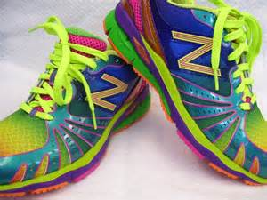
Needed Information
Backpacks and a Large Trapper Keeper
  As of right now, lockers will not be used.
3 minutes to change classes
Tennis Shoes for P.E.
School-Issued Lanyard to Wear

Slide 9
Class Change
3 minutes
Tardies add up
  (Starts over every 9 weeks)
1st and 2nd tardy will be recorded, but no
disciplinary action will be taken.
3rd tardy to class/school = 1 school detention
4th tardy to class/school = 2 school detentions
5th tardy to class/school = 3 school detentions and Parent Conference.
6th tardy to class/school = ISS placement
7th tardy to class/school = 1 day of School Suspension
  Parents are notified by letter or phone.
  Detention is until 4:30 on Tues., Wed., & Thurs.
Excessive tardies= ISS

Slide 10
Immunizations
Rising 5th graders (2014-2015 School Year)- The Alabama Department of Public Health requires all students entering 6th grade receive the Tdap vaccination.
Tdap- TDap is a combined Tetanus, Diphtheria and Pertussis vaccine. Recommended for kids ages 11-18
Notes:
Whooping cough-diphtheria/ pertussis
Tetanus is often the result of an infection that enters the body through an open wound. The tetanus condition, also known as lockjaw, is caused by the clostridi. Tetanus is a bacterial disease caused by a toxin. Clostridium tetani spores (spores of tetanus bacteria) are found most often in soil but are present everywhere. The disease affects muscles, especially the jaw and neck muscle

Slide 11
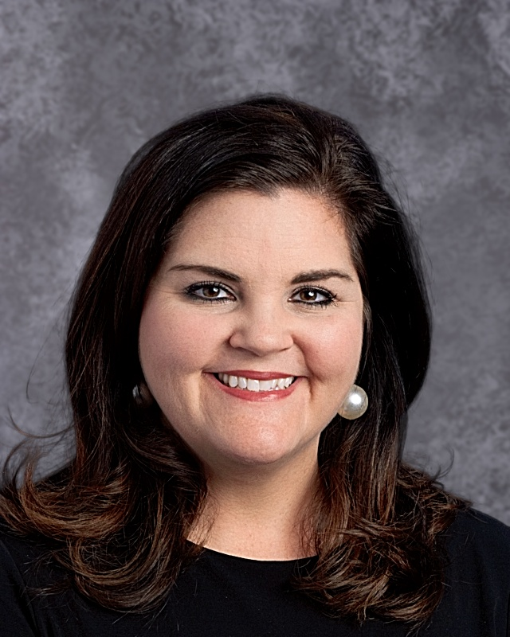
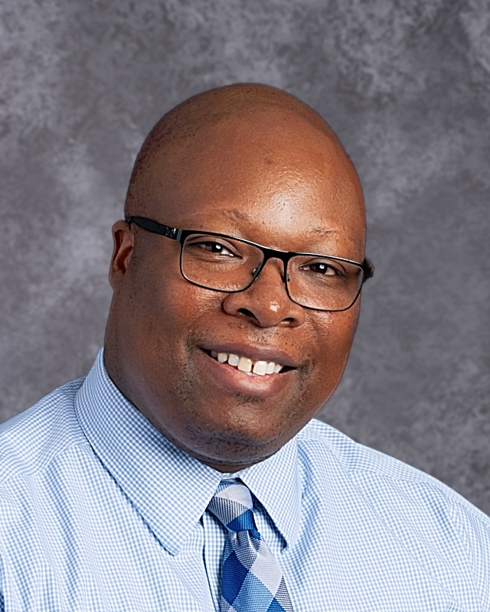
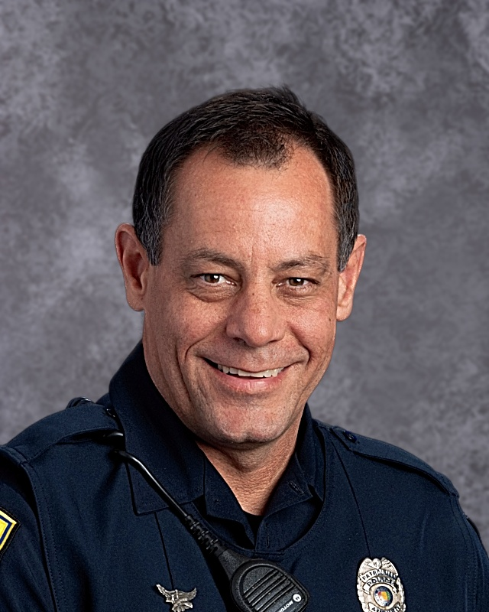
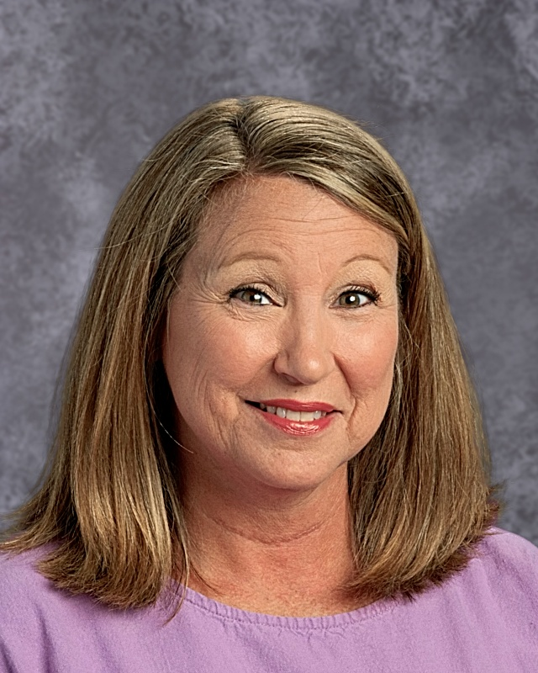
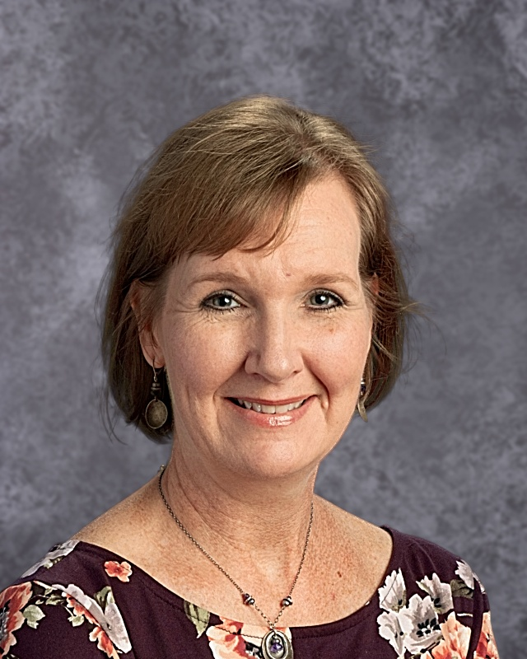
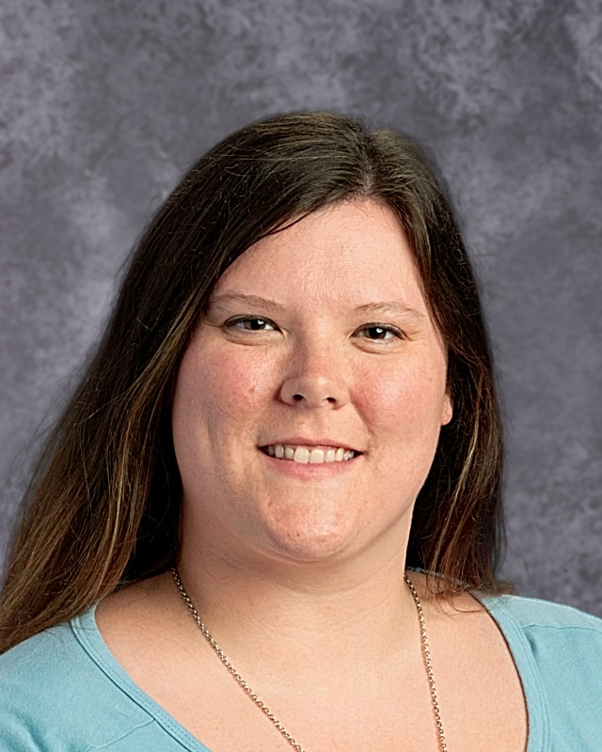
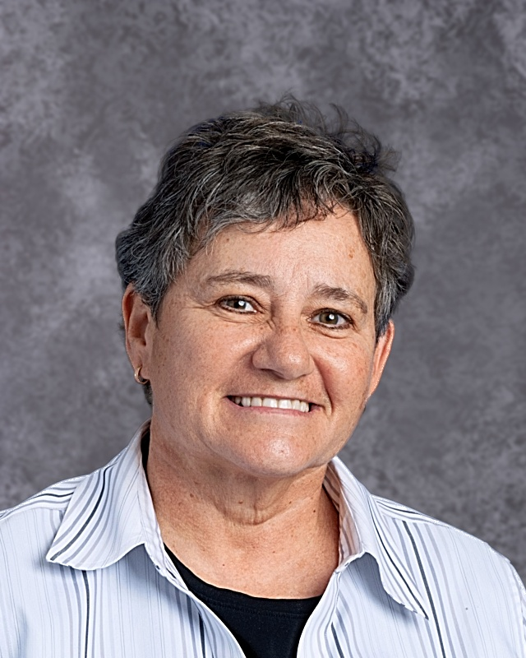
Key Faculty & Staff
Mrs. Sarah Armstrong, Principal
Dr. Jonathan Finch, Assistant Principal
Ron Askelson,
SRO
Kim Boston,
Secretary
Laura Hardy,
Media Specialist
Beth Jones,
Nurse
Elizabeth Talley,
Bookkeeper

Slide 12
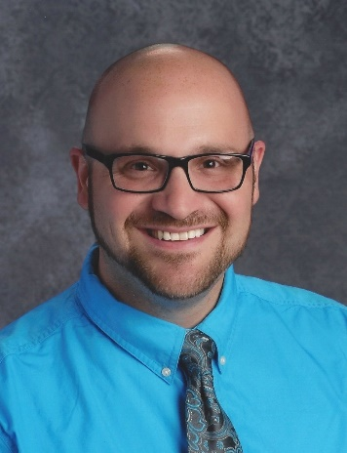
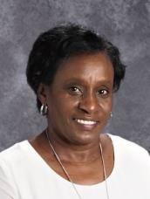
Counselors
Mr. Adam Keel:
6 years middle & high school English teacher
7 years school counselor
Ms. Joanne Smith:
11 years at Drake
31 years in education.
11 year:
11 year1th year at Drake; 31st year in edu11th year at Drake; 31st year in education
cation

Slide 13
Until we meet again…
Remember I love you and want the best for each of you.
If you have any questions about the transition to Drake, please email me at :
blhooks@auburnschools.org
Peace, Love and Understanding…until we meet again in person!

